Slide 1
Solar Tracking System
CONTENT
INTRODUCTION
WHAT IS SOLAR TRACKERS
NEED OF SOLAR TRACKERS
TYPES OF SOLAR TRACKERS
INTERNAL BIOCK DIAGREM
WORKING PRINCIPLE
HARDWARE COPONENTS OF SOLAR TRACKER
COMPARISON OF STATIONARY VS TRACKED SOLAR ENERGY
ADVANTAGES
DISADVANTAGES
CONCLUTION
REFERENCE
Design of mechatronics-N
MCH362
Supervised:DR.Abdelaziz Hussien

Slide 2
Solar Tracking System
CONTENT
Team members and their tasks
Introduction
What is solar trackers
Need Of Solar Trackers
Types Of Solar Trackers
Hardware Coponents Of Solar Tracker
System Modelling
Block Digram
Matlab Simulation
Flow chart
Advantages & Disadvantages
Conclusion
Future Work
Design of mechatronics-N
MCH362
INTRODUCTION
Renewable energy solutions are becoming popular.
Maximizing output from solar system increases efficiency.
Presently solar panels are of fixed type which lower the efficiency.
Maintaining vertical direction between light and panel maximizes efficiency.
Solar tracking system has 35% higher generating power than fixed
Solar tracking system based on PLC can adjust automatically orientation of panel

Slide 3
Team members and their tasks
Bahaa Adel (Mathematical modeling)
Bassant Mohamed (Matlab Simulation)
Islam Nagi (report , codeing)
Mohamed Foad (Mathematical modeling , Assembling parts)
Omar Khaled (Electronics Modeling)
Waled Magdy (design S.W)

Slide 4
CONTENT
INTRODUCTION
WHAT IS SOLAR TRACKERS
NEED OF SOLAR TRACKERS
TYPES OF SOLAR TRACKERS
INTERNAL BIOCK DIAGREM
WORKING PRINCIPLE
HARDWARE COPONENTS OF SOLAR TRACKER
COMPARISON OF STATIONARY VS TRACKED SOLAR ENERGY
ADVANTAGES & DISADVANTAGES
CONCLUTION
REFERENCE
Introduction
Renewable energy solutions are becoming popular.
Maximizing output from solar system increases efficiency.
Presently solar panels are of fixed type which lower the efficiency.
Maintaining vertical direction between light and panel maximizes efficiency.
Solar tracking system has 35% higher generating power than fixed
Solar tracking system based on PLC can adjust automatically orientation of panel

Slide 5
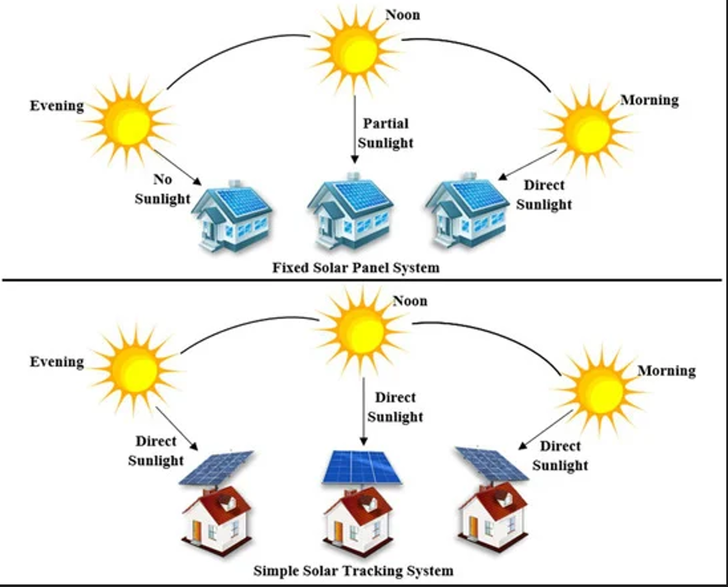
CONTENT
INTRODUCTION
WHAT IS SOLAR TRACKERS
NEED OF SOLAR TRACKERS
TYPES OF SOLAR TRACKERS
INTERNAL BIOCK DIAGREM
WORKING PRINCIPLE
HARDWARE COPONENTS OF SOLAR TRACKER
COMPARISON OF STATIONARY VS TRACKED SOLAR ENERGY
ADVANTAGES & DISADVANTAGES
CONCLUTION
REFERENCE
What Is Solar Trackers
A solar tracker is a device that orients a
payload toward the Sun. Payloads are usually solar panels
Note:trackers are used to minimize the angle of incidence between the incoming sunlight and a photovoltaic panel, sometimes known as the cosine error. Reducing this angle increases the amount of energy produced from a fixed amount of installed power-generating capacity

Slide 6
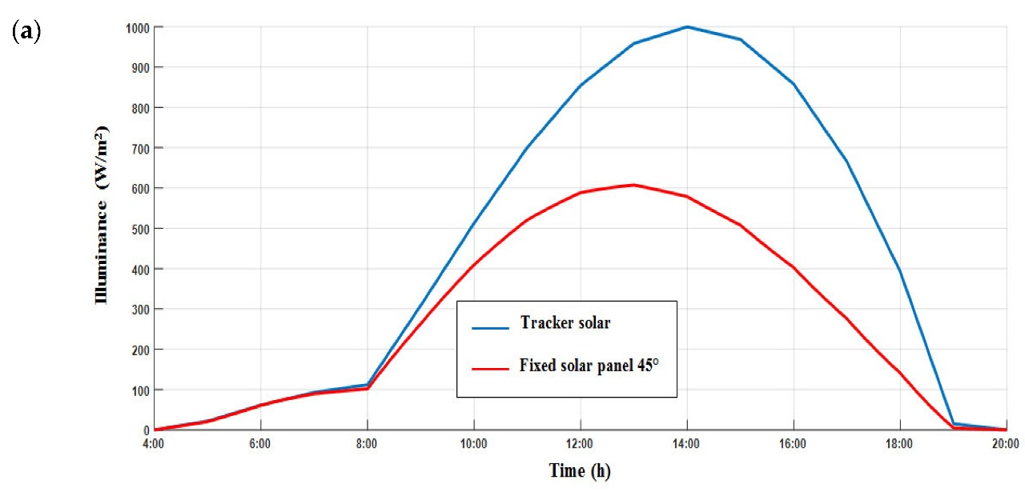
Need Of Solar Trackers
Increase Solar Panel Output.
Max. efficency of the panel.
Maximize Power per unit Area.
Able to grab the energy through
out the day.

Slide 7
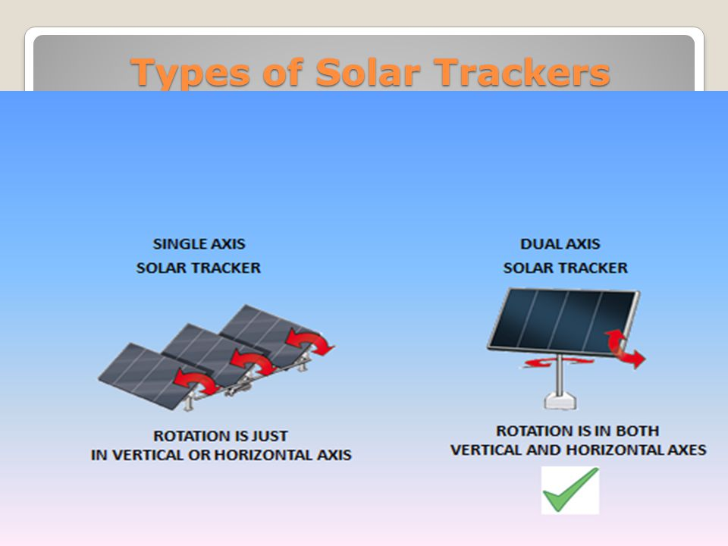
Types Of Solar Trackers

Slide 8
Hardware Coponents Of Solar Tracker
Solar panel
2 x Servo motor
Arduino uno
4 x LDR sensors
DC to DC converter step up
Lipo charger battery
2 xBattery 3.7V

Slide 9
System Modelling
Soildwork (Waled)
Mathemtical Model(Bahaa,Mohamed)
Motors
solar panel
Electronics Modeling(Omar)

Slide 10
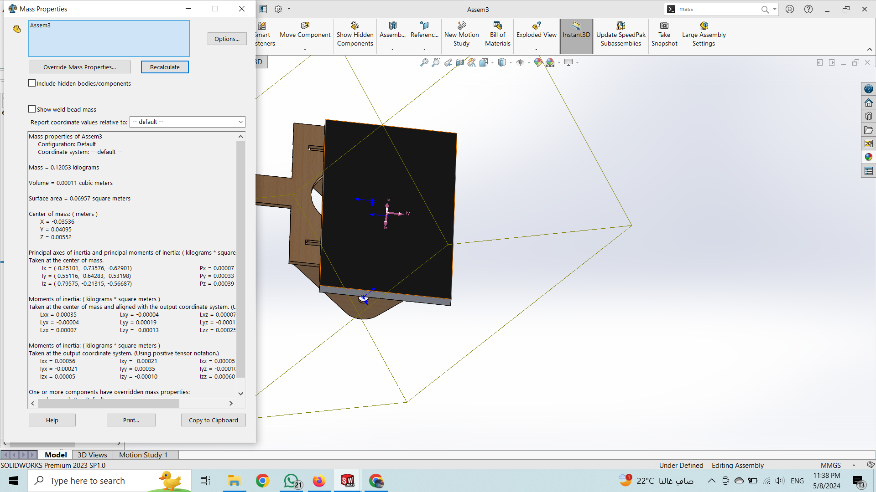
Solidwork

Slide 11
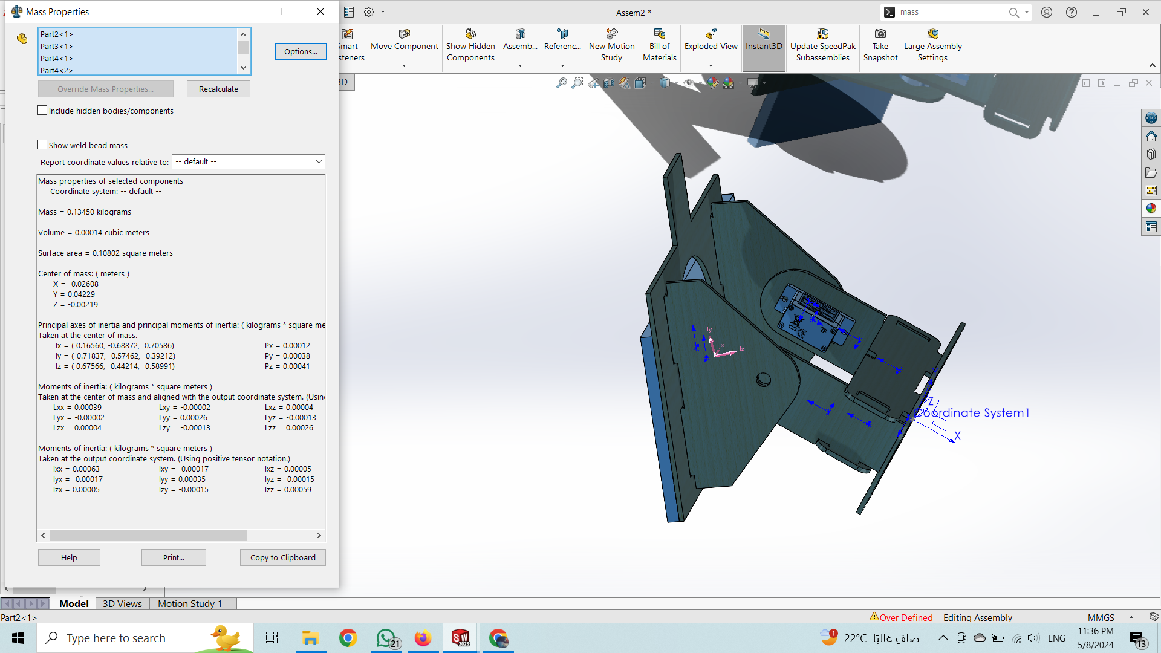

Slide 12
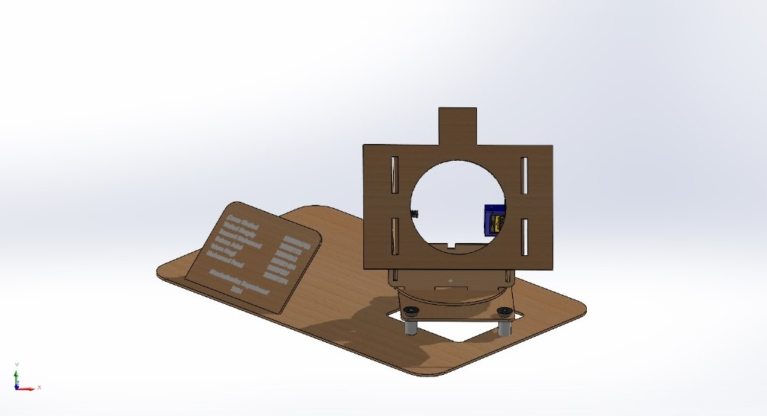
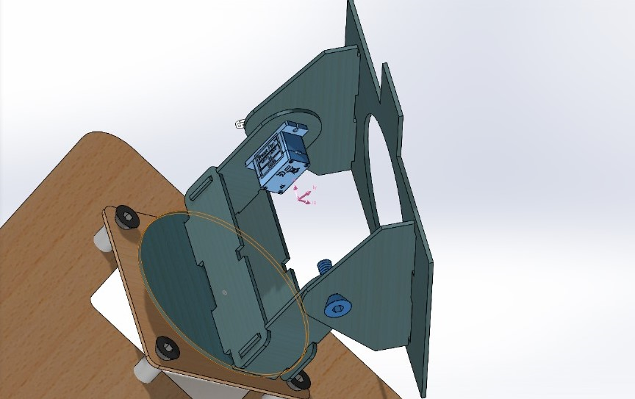

Slide 13
Mathematical Model
(motors)

Slide 14
Mathematical Model
(solar panel)

Slide 15
Calculation of solar system
Step 1 :Load Arduino uno
Step 2 :Battery size selection in AH
Step 3 :charging current
Step 4 :solar panel selection
Step 5 :solar plates power

Slide 16
Step1:Load Arduino uno selection
I=100mA
Arduino DC volt =5V
required power for Arduino
P = V×I
=0.1×5 =0.5W

Slide 17
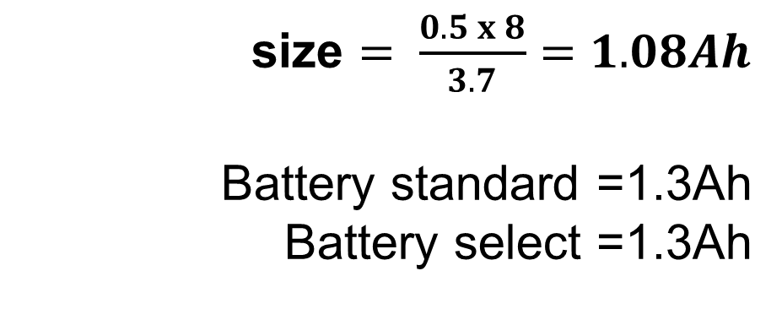
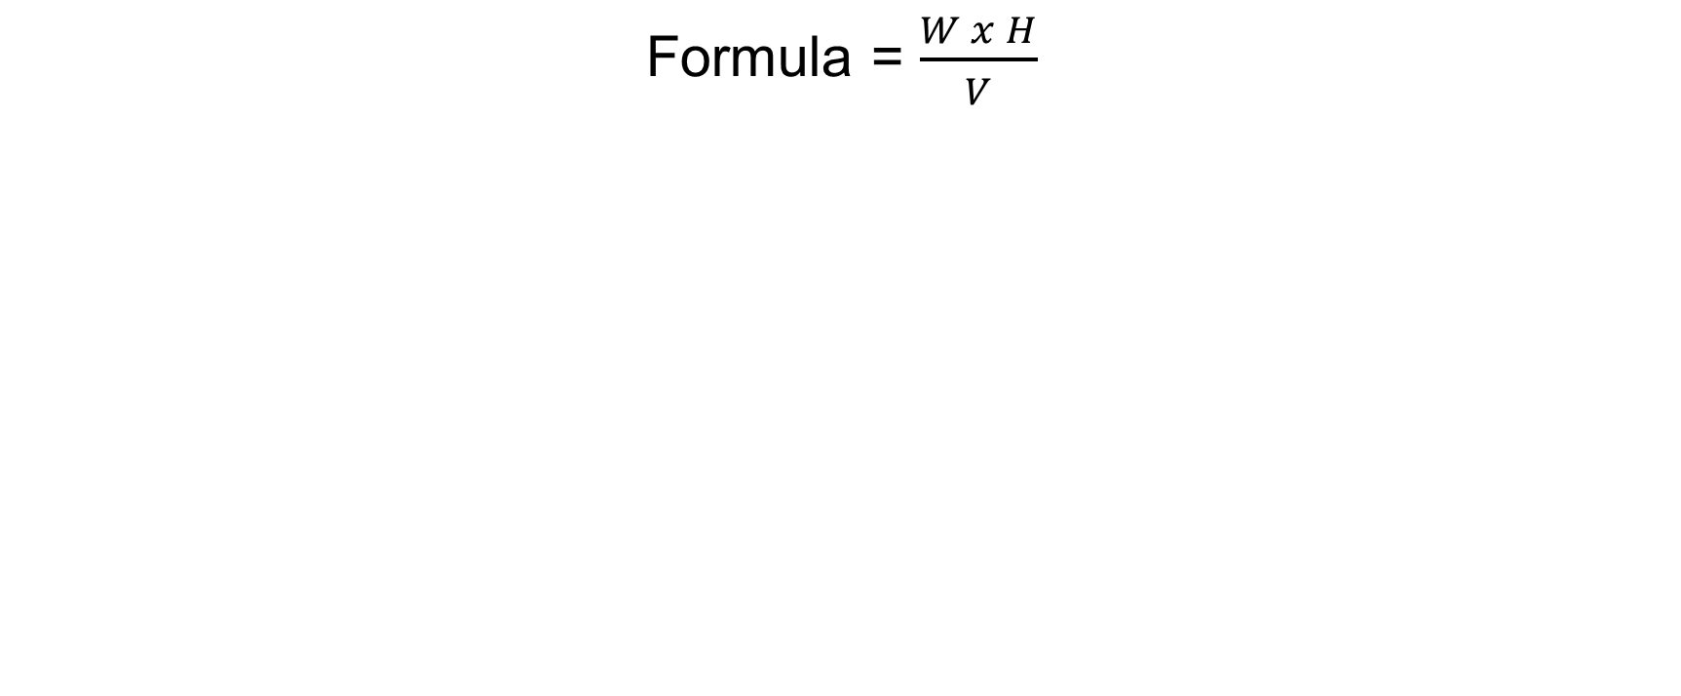
Step 2: battery size selection in Ah
Formula = $\frac{W x H}{V}$
size $= \frac{0.5 x 8}{3.7}=1.08Ah$
Battery standard =1.3Ah
Battery select =1.3Ah
Formula = W x Hv
W - total load power
H - Back up time in hours
V - battery voltage

Slide 18
Step 3 : charging current
We will calculate charging current for 1.3AH battery.
As we know that charging current should be 10%of the AH rating of battery.
Therefore,
charging current for 1.3AH Battery is
1.3×10%=0.13A

Slide 19
Step 4: solar plates current
= Battery chanrging current + Load current
=0.13+0.1
=0.23A

Slide 20
Step 5: Solar plates power
P = V×I
=6×0.23
=1.38W

Slide 21
Electronics Modeling

Slide 22
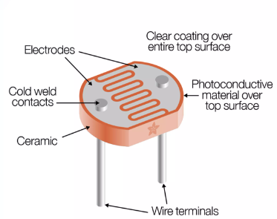
Electronics Modeling
Discrbsion COPONENTS:
LDR sensor(12mm)
A high resistance semiconductor whose resistance decreases with increasing incident light intensity.
When light falls on such a semiconductor, the valence electrons receive the light energy incident and jump to the conduction band.

Slide 23
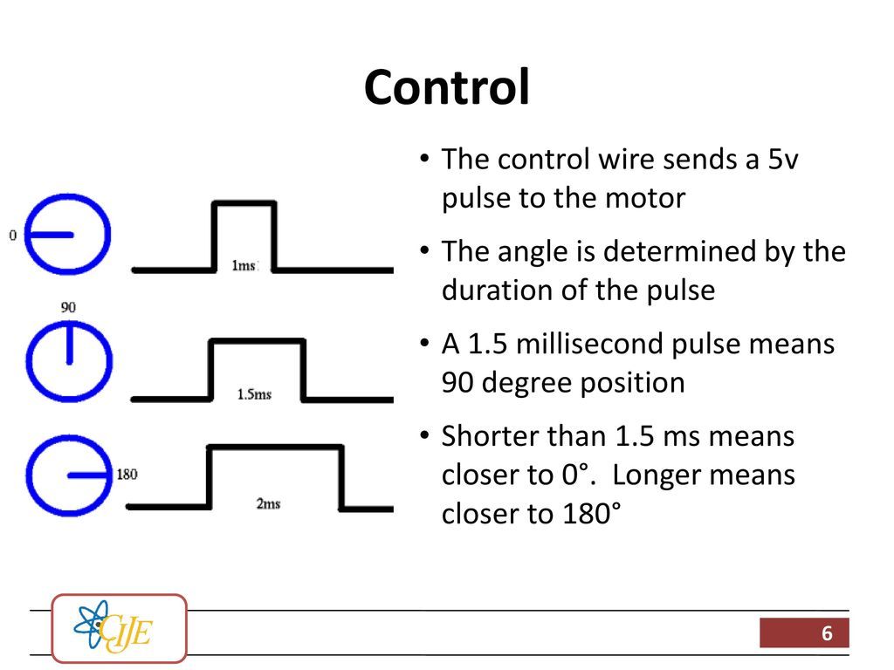
Servo motor(sg90)
Tiny and lightweight with high output power.
180 degrees (90 in each direction),
You can use any servo code, hardware or library to control these
servos. Good for beginners who want to make stuff move without
building a motor controller with feedback & gear box,
especially since it will fit in smallplaces.

Slide 24
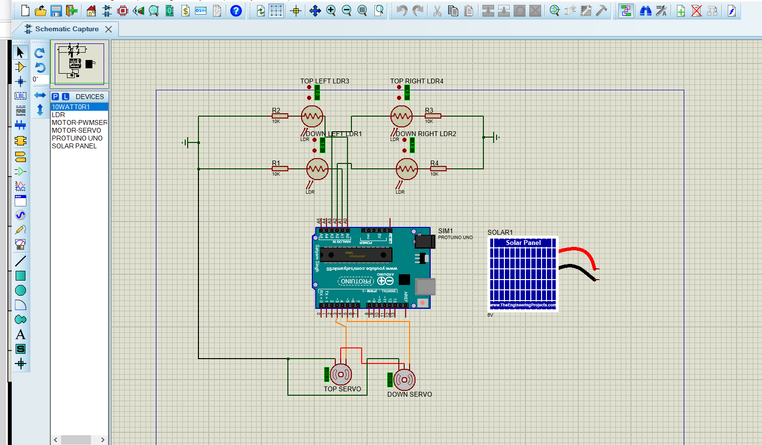
Cricuit

Slide 25
Block Digram
sun
Arduino uno
(PLC,Microconroller)
LDR
sensor
Sensor
signal
Arduino uno
(PLC,Microconroller)
analog
analog
PV
Servo
motor
signal
Pulse
digital
6V
Lipo
Charger
battery
Battery
3.7V
DC to DC converter
Step up 5V
CV/CC
3.7V
power

Slide 26
Matlab Simulation
(Bassant)

Slide 27
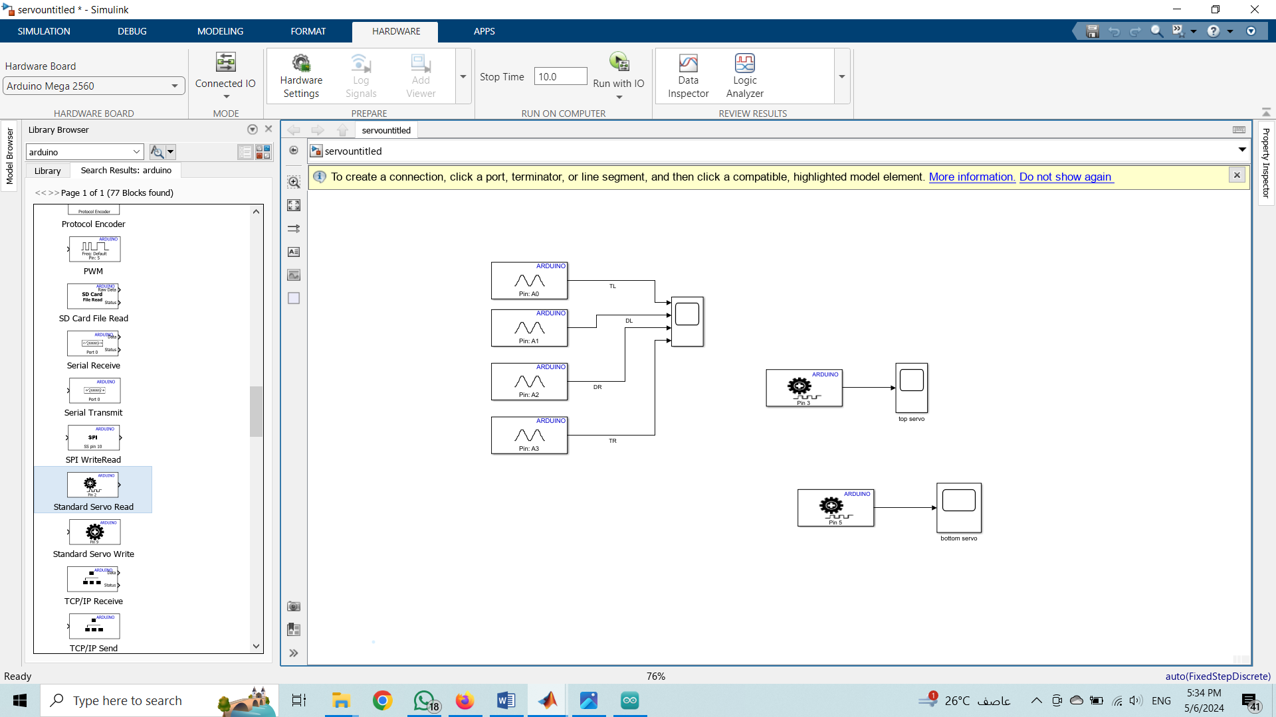
Solar Tracking

Slide 28
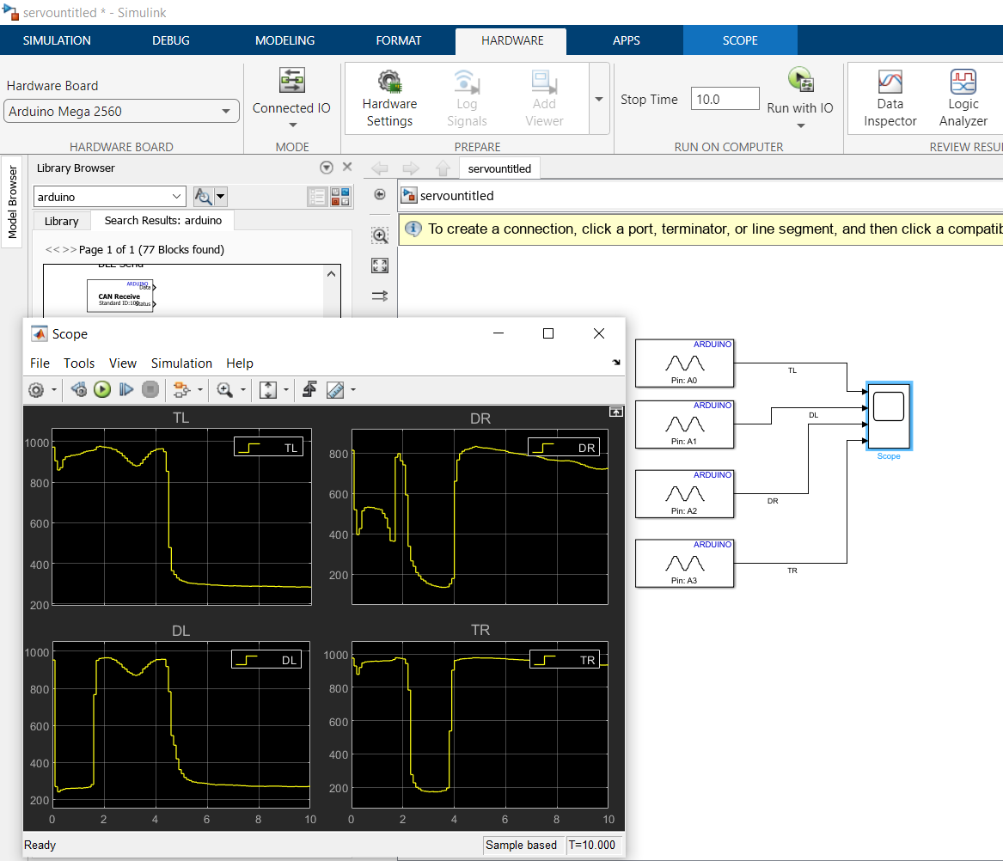
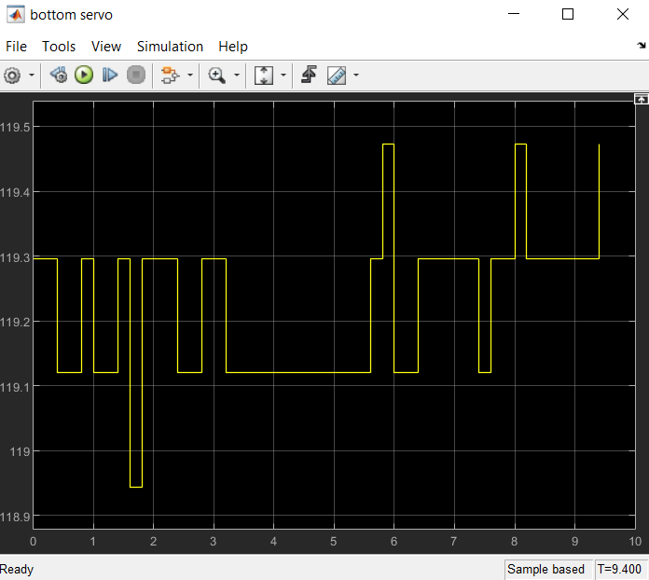
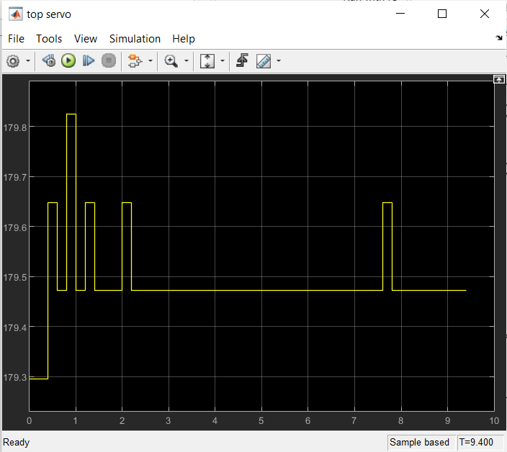
Solar Tracking

Slide 29
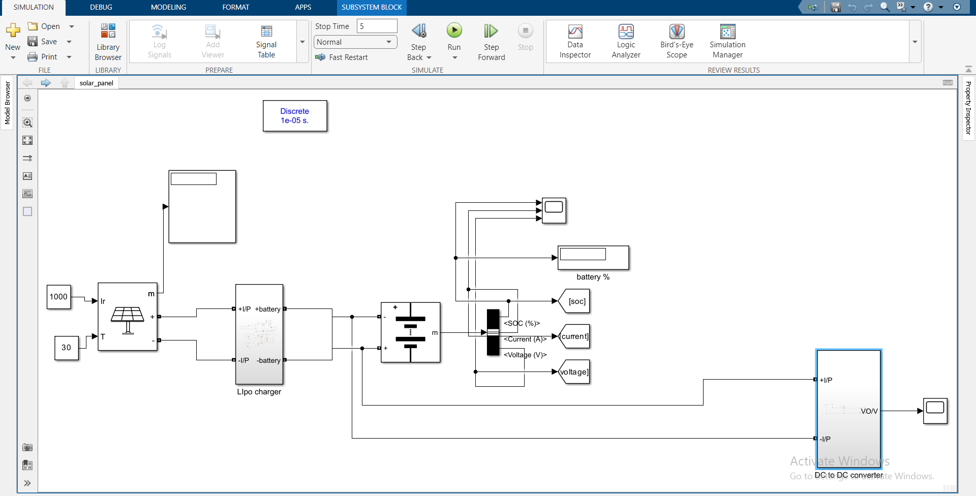
Solar panal

Slide 30
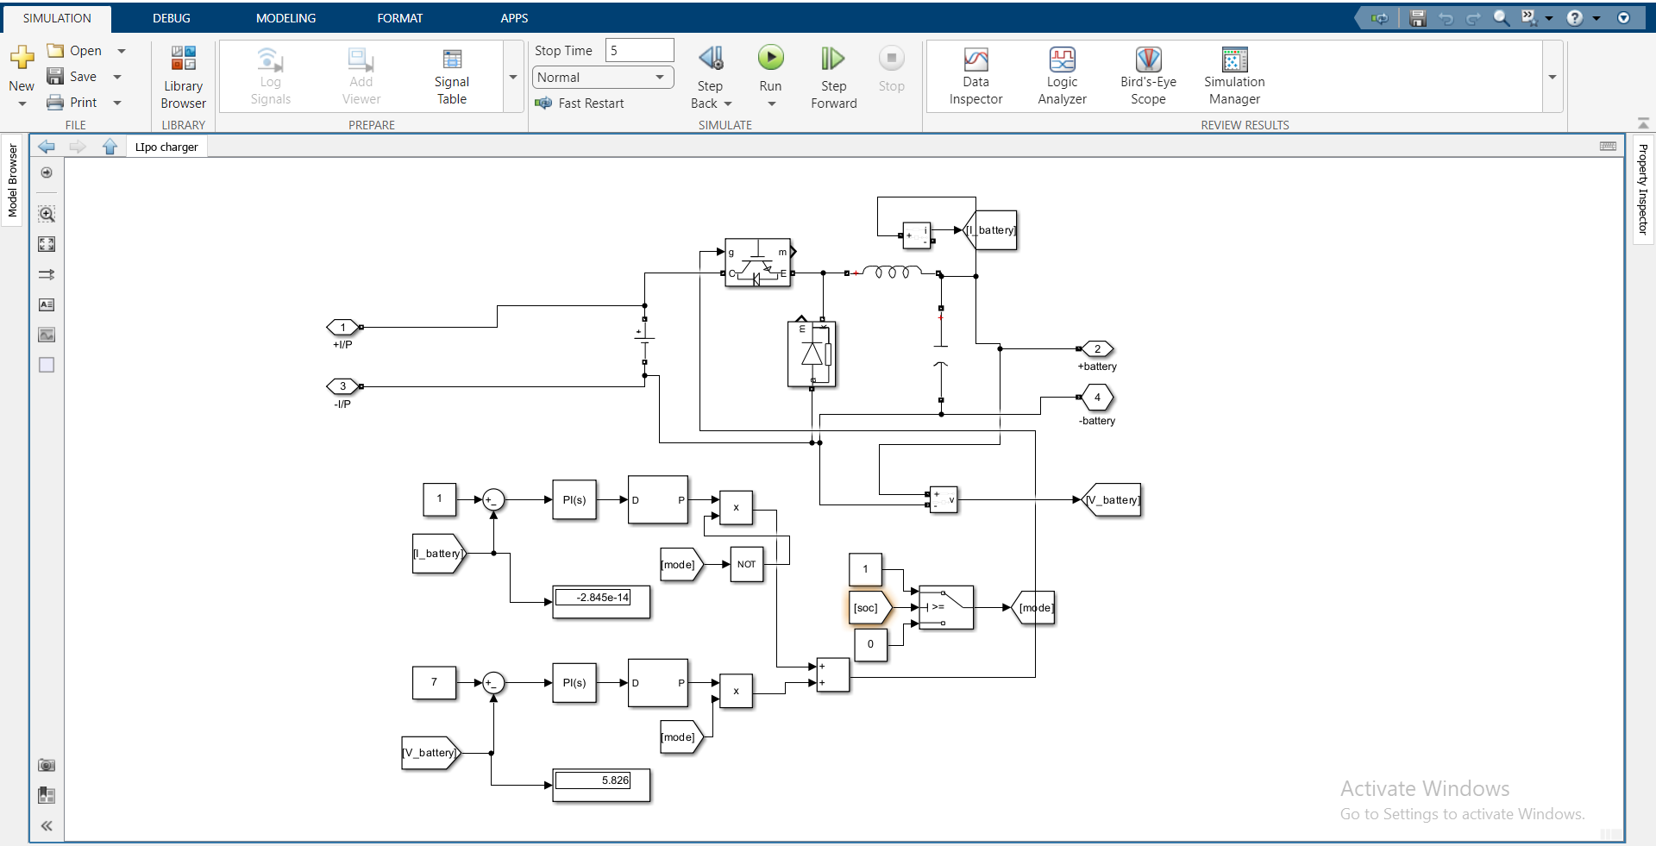
Lipo Charger

Slide 31
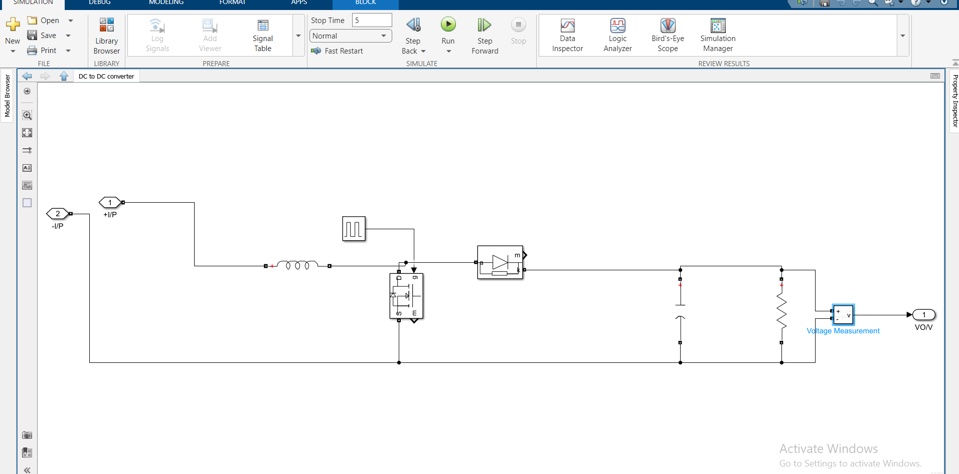
DC to DC Converter step up

Slide 32
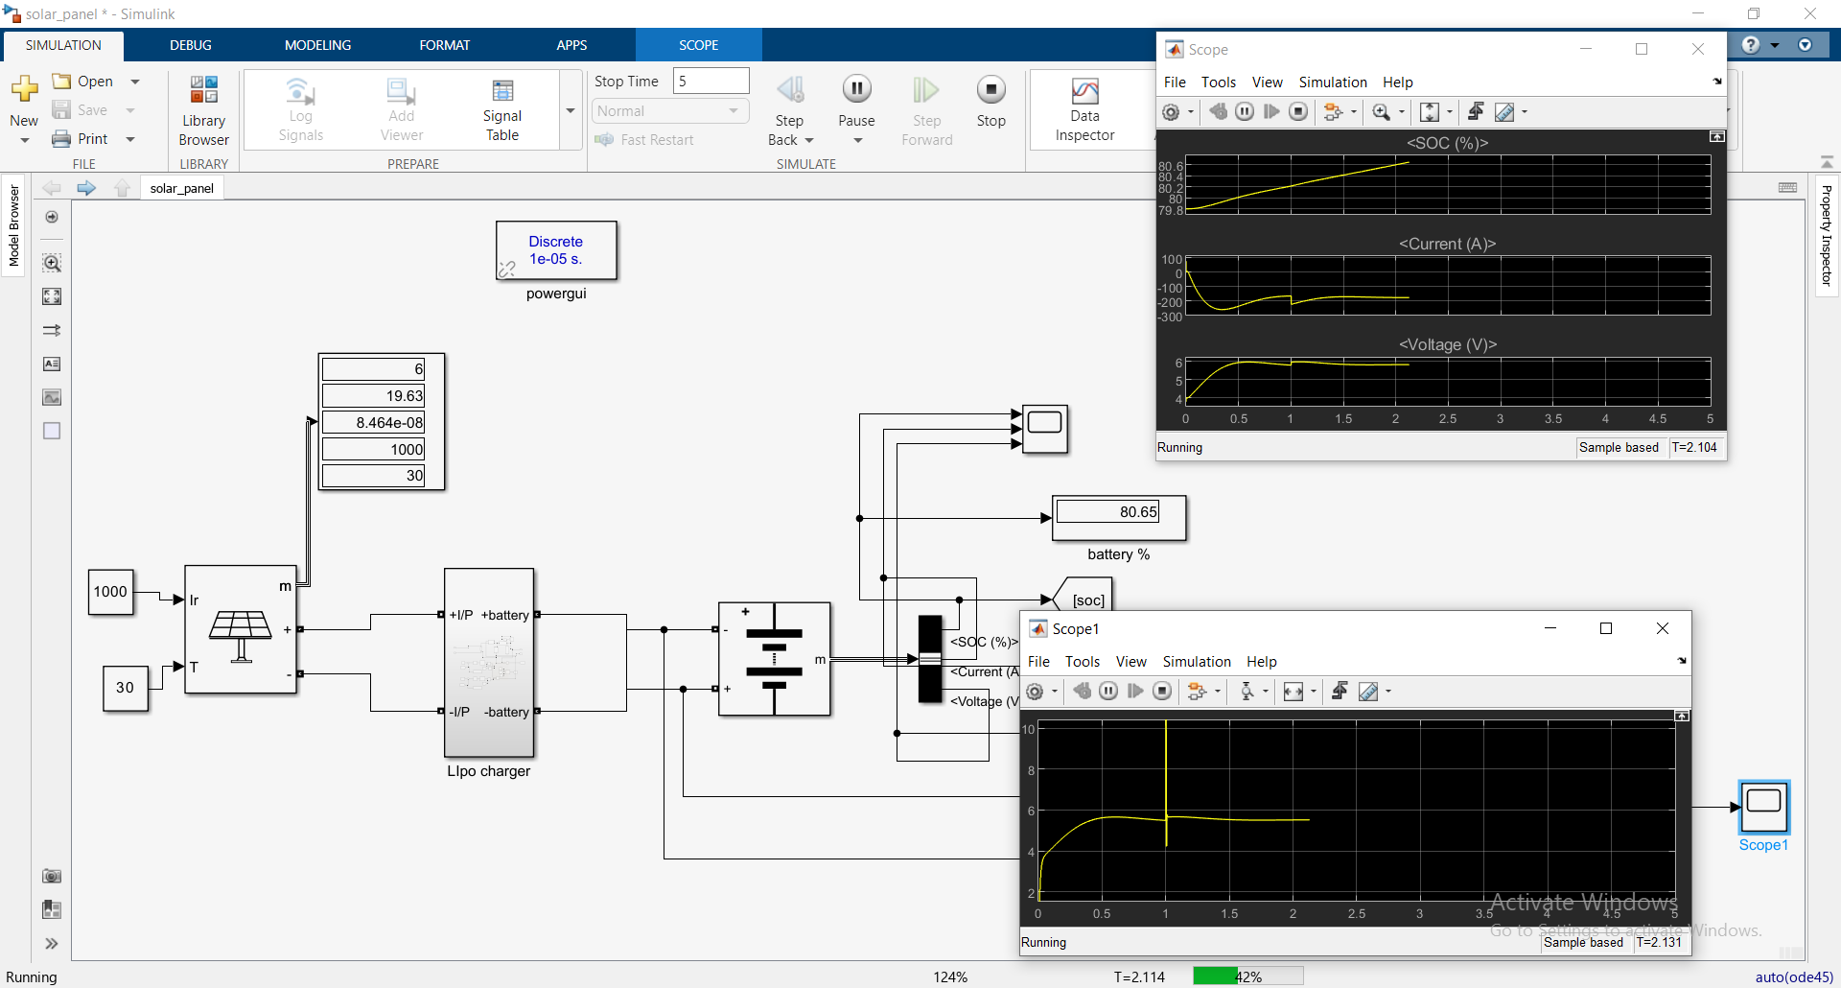

Slide 33
Flow Chart
(Islam)

Slide 34
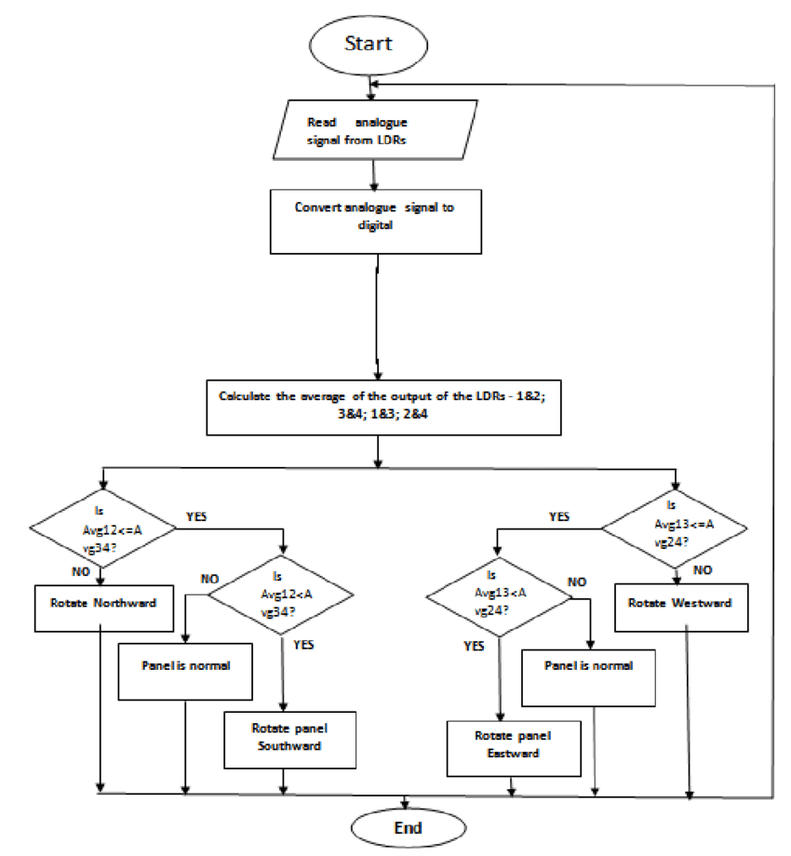
Flow chart

Slide 35
Advantages & Disadvantages

Slide 36
Advantages & Disadvantages
ADVANTAGES | DISADVANTAGES
Simple
Low cost | Solar electricity is not available at night and is less available in cloudy weather conditions. Therefore, a storage or complimentary power system is required
Eco-Friendly | Limited power density.
Tracking accuracy is more | Solar cells produce DC which must be converted to AC when used in currently existing distribution grids

Slide 37
Conclusion

Slide 38
Conclusion
The invention of Solar Tracking System helps us improve the performance of PV solar system in a simple way
Used relative method of sunlight strength.
Established a model of automatic tracking system to keep vertical contact between solar panels and sunlight.
Improved the utilization rate of solar energy and efficiency of photovoltaic power generation system.

Slide 39
Future Work

Slide 40
Future Work
Improved algorithm for tracking
Multi-axis tracking
Sensor integration
Power optimization
Scalability
Energy storage integration

Slide 41
Thank you

Slide 42
Lab view
Solar tracking

Slide 43
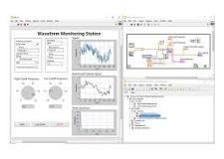
What is the labview?
LabVIEW is a graphical programming environment that provides unique productivity accelerators for test system development, such as an intuitive approach to programming, connectivity to any instrument, and fully integrated user interfaces.

Slide 44
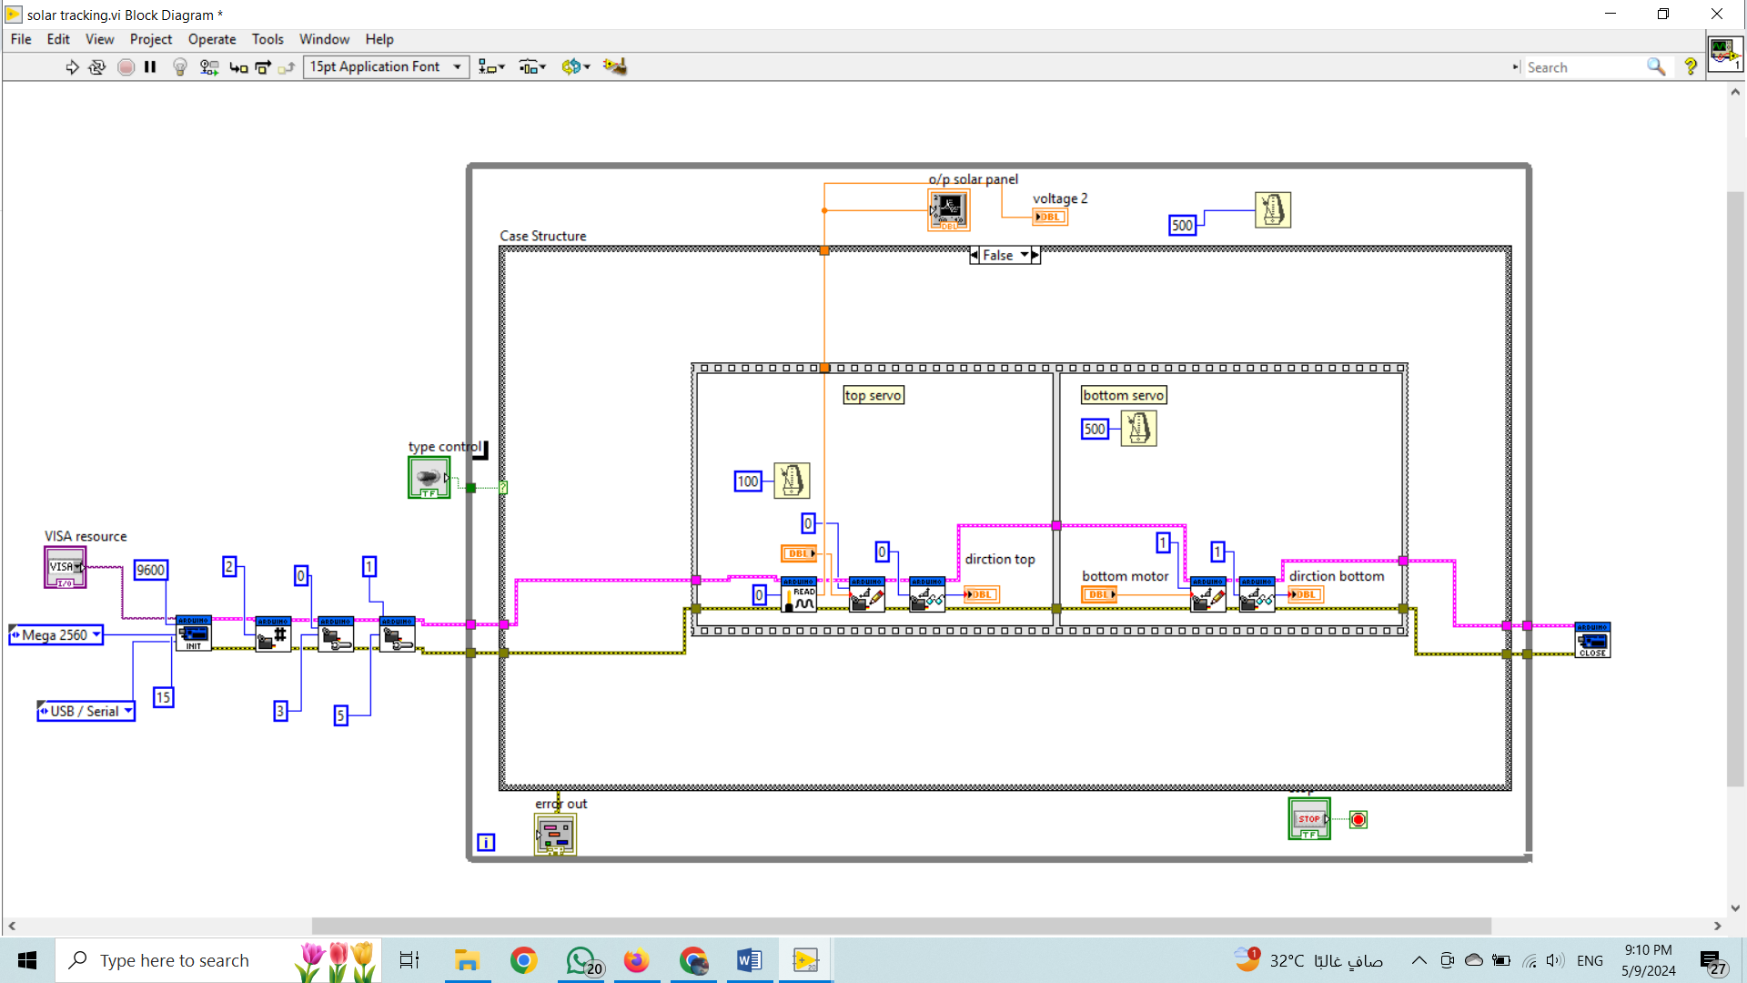
Block digram

Slide 45
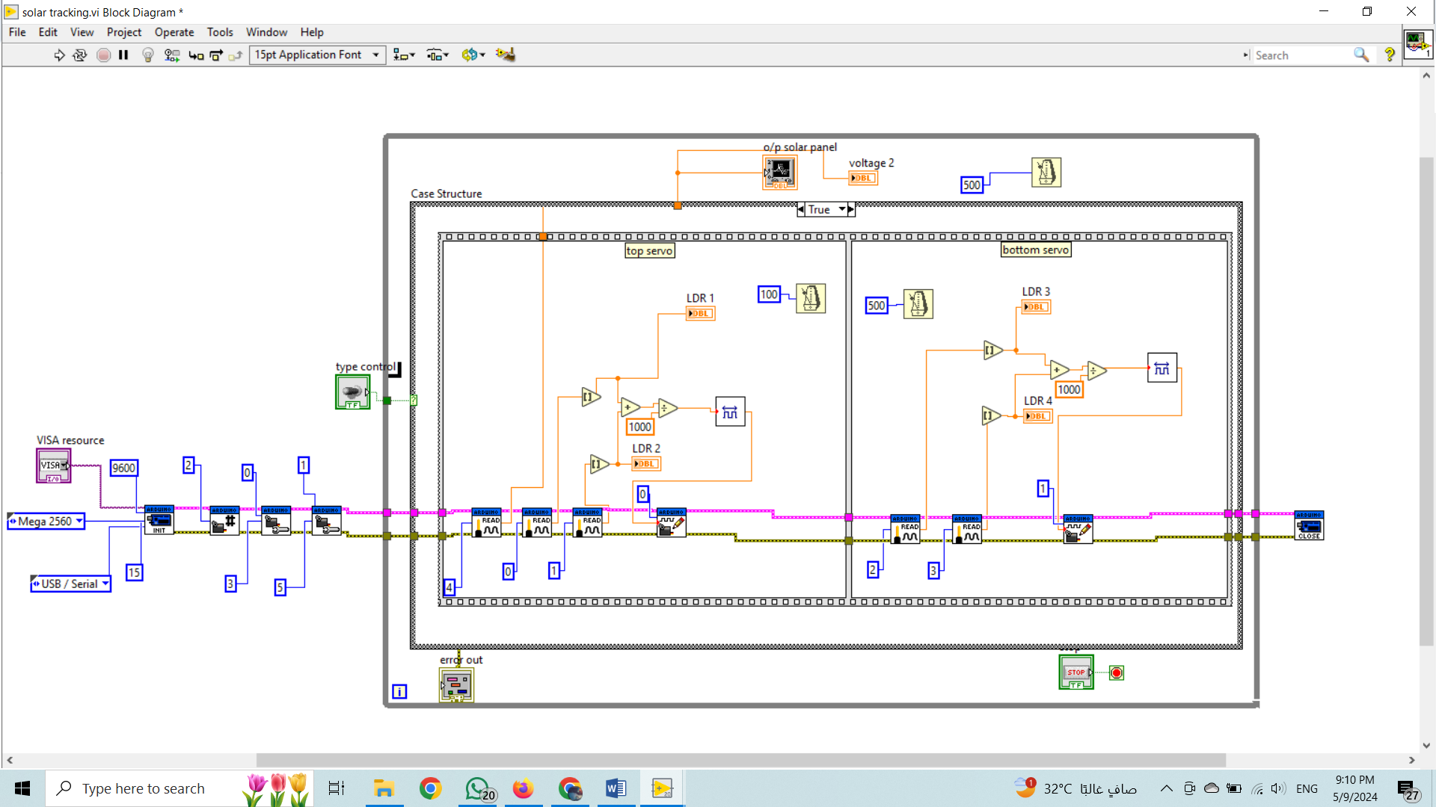
Block digram

Slide 46
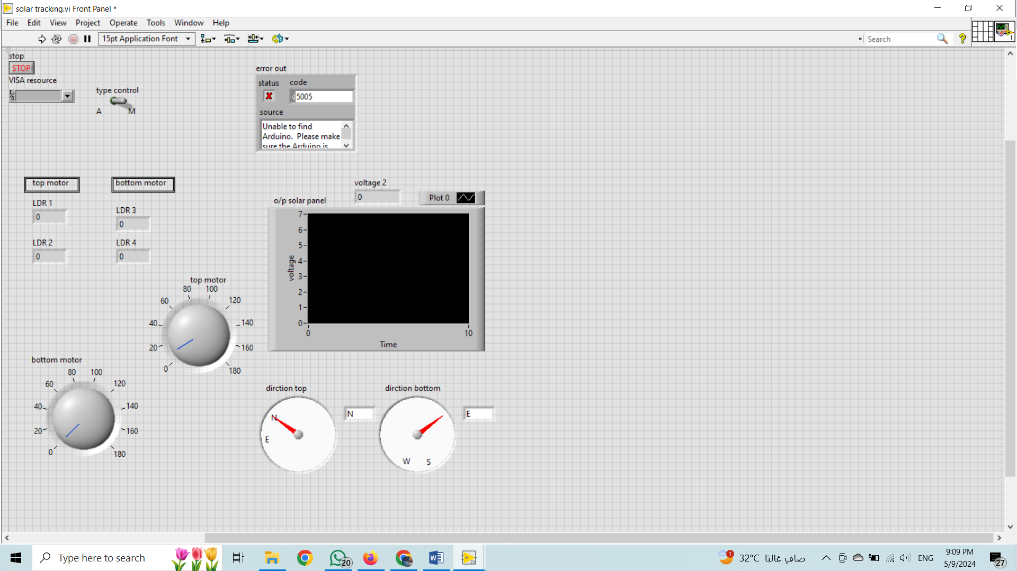
Front panel

